Slide 1
Logistic Regression - Day 1
Notes:
Highlights: Introduce yourself and the session.
Key Takeaways: NA

Slide 2
Logistic Regression - Day 1
In this session, you will explore the given topics:
01
02
03
04
05
Classification problems
Solving classification problems using linear regression
Interpreting coefficients of a logistic model
Finding out the optimal coefficients
Python demo
Notes:
Duration: 2 minutes
Highlights: Connect the discussion to the topics for the day. Provide an overview the concepts and tasks that will be covered in the session. Introduce the session outcomes.
Key Takeaways: What should learners be able to do at the end of this session?

Slide 3
Classification Problems

Slide 4

Classification Problems
Predict if a machine will fail in the next 14 days.
VibrationX_14day | VibrationY_14day | VibrationZ_14day | Failed
… | … | … | Yes
… | … | … | No
Notes:
Duration: 10 minutes
Highlights:
Introduce the definition.
Identify the unique attributes.
Provide examples to elaborate the concept and non-examples to show the difference.
Use whiteboard if required.
Key Takeaways:
In what ways, learners can use the concept in real-life situations to provide solutions or solve problems.

Slide 5

Classification Problems
The HR department of a company wants to understand which employees are at risk of resigning.
# promotions | Current salary | Market Salary | Resigned
... | ... | ... | Yes
... | ... | ... | No
Notes:
Duration: 10 minutes
Highlights:
Introduce the definition.
Identify the unique attributes.
Provide examples to elaborate the concept and non-examples to show the difference.
Use whiteboard if required.
Key Takeaways:
In what ways, learners can use the concept in real-life situations to provide solutions or solve problems.

Slide 6
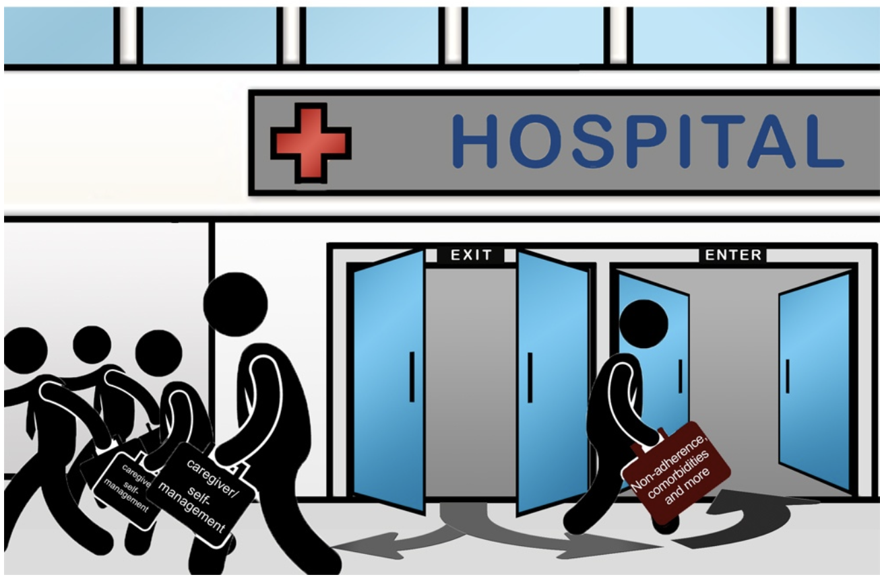
Classification Problems
Can we predict which patients are at risk of re-admission?
Patient ID | Age | Gender | ….
001 | 23 | M | …
Patient ID | Age | Gender | ….
Notes:
Duration: 10 minutes
Highlights:
Introduce the definition.
Identify the unique attributes.
Provide examples to elaborate the concept and non-examples to show the difference.
Use whiteboard if required.
Key Takeaways:
In what ways, learners can use the concept in real-life situations to provide solutions or solve problems.

Slide 7

Classification Problems: Class Exercise
Take five minutes and discuss two scenarios in which the prediction problem is a classification problem. Also, discuss what kind of data you will need to collect.
Customer Churn Prediction: Demographics, Past association with a product, and Number of times complaints registered
Predicting Fraud: Demographics, Financial History, and Circumstances of transaction
Notes:
Duration: 10 minutes
Highlights:
Introduce the definition.
Identify the unique attributes.
Provide examples to elaborate the concept and non-examples to show the difference.
Use whiteboard if required.
Key Takeaways:
In what ways, learners can use the concept in real-life situations to provide solutions or solve problems.

Slide 8
Fitting Lines

Slide 9
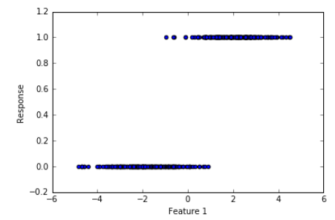
Supervised Learning: Fitting lines
Feature 1 (Age_Normalized) | Feature 2 (Income_Normalized) | Response (Good/Bad) | Feature 1 (Age_Normalized)
….. | …… | Good = 1 | …..
….. | …… | Bad = 0 | …..
Fit a model of the form, Response=b0+b1Feature1
Notes:
Duration: 10 minutes
Highlights:
Introduce the definition.
Identify the unique attributes.
Provide examples to elaborate the concept and non-examples to show the difference.
Use whiteboard if required.
Key Takeaways:
In what ways, learners can use the concept in real-life situations to provide solutions or solve problems.

Slide 10
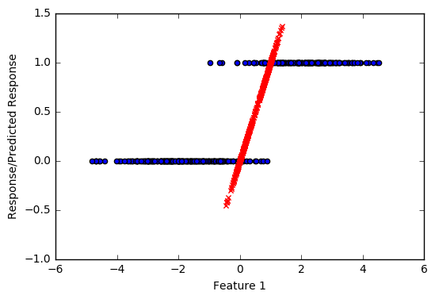
Supervised Learning: Fitting lines
We fit a straight line to the data, where the response is binary in nature 𝑦∈{0,1}.
Notice the predictions in red color
Predictions < 0 or Predictions > 1
0 < Predictions < 1
We are trying to fit:
𝑦 ̂= β0+β1𝑋1+β2𝑋2+ε=𝑓(𝑋1,𝑋2)
The problem with the fitting linear model is:
𝑓(𝑋1,𝑋2)∈(−∞,+∞)
𝑦∈{0,1}
Notes:
Duration: 10 minutes
Highlights:
Introduce the definition.
Identify the unique attributes.
Provide examples to elaborate the concept and non-examples to show the difference.
Use whiteboard if required.
Key Takeaways:
In what ways, learners can use the concept in real-life situations to provide solutions or solve problems.

Slide 11
Supervised Learning: Fitting lines
Age | Target
20 | 1
20 | 0
21 | 1
21 | 0
Age | Proportion (1)
20 | 0.50
21 | 0.50
Notes:
Duration: 10 minutes
Highlights:
Introduce the definition.
Identify the unique attributes.
Provide examples to elaborate the concept and non-examples to show the difference.
Use whiteboard if required.
Key Takeaways:
In what ways, learners can use the concept in real-life situations to provide solutions or solve problems.

Slide 12
Supervised Learning: Fitting lines
Instead of estimating 𝑦∈{0,1} we can try to estimate the Prob(y=1) = 𝑝 ̂
𝑝 ̂∈(0,1)
These estimates make sense now.
We are trying to fit:
𝑝 ̂ = β0+β1𝑋1+β2𝑋2+ε = 𝑓(𝑋1,𝑋2)
The problem still is:
𝑓(𝑋1,𝑋2) ∈ (−∞,+∞)
𝑝 ̂ ∈ (0,1)
Notes:
Duration: 10 minutes
Highlights:
Introduce the definition.
Identify the unique attributes.
Provide examples to elaborate the concept and non-examples to show the difference.
Use whiteboard if required.
Key Takeaways:
In what ways, learners can use the concept in real-life situations to provide solutions or solve problems.

Slide 13
Supervised Learning: Fitting lines
Age | Target
20 | 1
20 | 1
20 | 1
20 | 0
21 | 1
21 | 0
Age | Pr (1) | Pr/1-Pr
20 | 0.75 | 3
21 | 0.50 | 0.5
Notes:
Duration: 10 minutes
Highlights:
Introduce the definition.
Identify the unique attributes.
Provide examples to elaborate the concept and non-examples to show the difference.
Use whiteboard if required.
Key Takeaways:
In what ways, learners can use the concept in real-life situations to provide solutions or solve problems.

Slide 14
Supervised Learning: Fitting lines
Age | Target
20 | 1
20 | 1
20 | 1
20 | 0
21 | 1
21 | 0
Age | Pr (1) | Pr/1-Pr
20 | 0.75 | 3
21 | 0.50 | 0.5
Maximum and Minimum value Pr/(1-Pr)?
Minimum value of Pr(1)?
Pr(1) = 0
Maximum value of Pr(1)?
Pr(1) = 1
Min Pr(1) = 0, Pr/(1-Pr) = ?
Pr/(1-Pr) = 0
Max Pr(1) = 1, Pr/(1-Pr) = ?
Pr/(1-Pr) = Infinity
0<=Pr/(1-Pr)<=Infinity
Notes:
Duration: 10 minutes
Highlights:
Introduce the definition.
Identify the unique attributes.
Provide examples to elaborate the concept and non-examples to show the difference.
Use whiteboard if required.
Key Takeaways:
In what ways, learners can use the concept in real-life situations to provide solutions or solve problems.

Slide 15
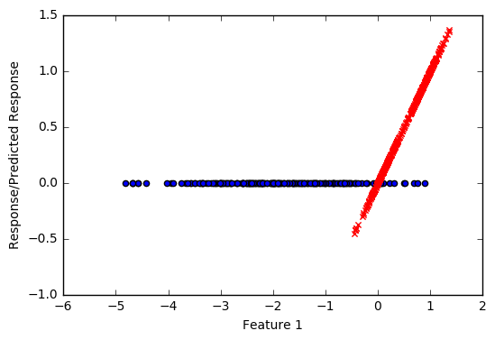
Supervised Learning: Fitting lines
Instead of estimating 𝑦∈{0,1} we can try to estimate the 𝑝 ̂/(1−𝑝 ̂ )
𝑝 ̂/(1−𝑝 ̂ ) ∈ (0,+∞)
These estimates make sense now.
We are trying to fit:
𝑝 ̂/(1−𝑝 ̂ )= β0+β1𝑋1+β2𝑋2+ε = 𝑓(𝑋1,𝑋2)
The problem still is:
𝑓(𝑋1,𝑋2)∈(−∞,+∞)
𝑝 ̂/(1−𝑝 ̂ )∈(0,+∞)
Notes:
Duration: 10 minutes
Highlights:
Introduce the definition.
Identify the unique attributes.
Provide examples to elaborate the concept and non-examples to show the difference.
Use whiteboard if required.
Key Takeaways:
In what ways, learners can use the concept in real-life situations to provide solutions or solve problems.

Slide 16
Supervised Learning: Fitting lines
Age | Target
20 | 1
20 | 1
20 | 1
20 | 0
21 | 1
21 | 0
Age | Pr (1) | Pr/1-Pr | log(Pr/(1-Pr))
20 | 0.75 | 3 | 1.09
21 | 0.50 | 0.5 | -0.70
0 <= Pr/(1-Pr) <= Infinity
-Infinity <= log(Pr/(1-Pr)) <= Infinity
Notes:
Duration: 10 minutes
Highlights:
Introduce the definition.
Identify the unique attributes.
Provide examples to elaborate the concept and non-examples to show the difference.
Use whiteboard if required.
Key Takeaways:
In what ways, learners can use the concept in real-life situations to provide solutions or solve problems.

Slide 17
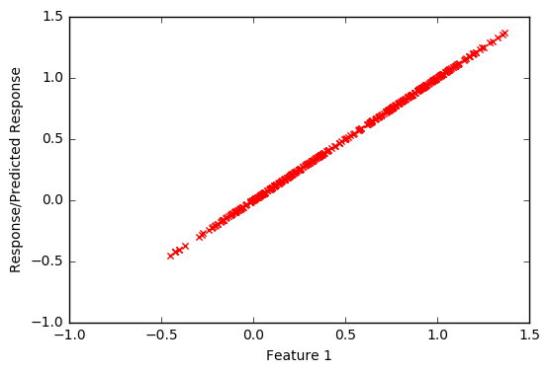
Supervised Learning: Fitting lines
Instead of estimating 𝑦∈{0,1} we can try to estimate the log(𝑝 ̂/(1−𝑝 ̂ ))
log𝑝 ̂/(1−𝑝 ̂ )∈(−∞,+∞)
All these estimates make sense now.
We are trying to fit:
log𝑝 ̂/(1−𝑝 ̂ )= β0+β1𝑋1+β2𝑋2+ε=𝑓(𝑋1,𝑋2)
𝑓(𝑋1,𝑋2)∈(−∞,+∞)log𝑝 ̂/(1−𝑝 ̂ )∈(−∞,+∞)
Notes:
Duration: 10 minutes
Highlights:
Introduce the definition.
Identify the unique attributes.
Provide examples to elaborate the concept and non-examples to show the difference.
Use whiteboard if required.
Key Takeaways:
In what ways, learners can use the concept in real-life situations to provide solutions or solve problems.

Slide 18
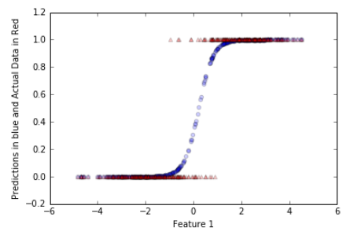
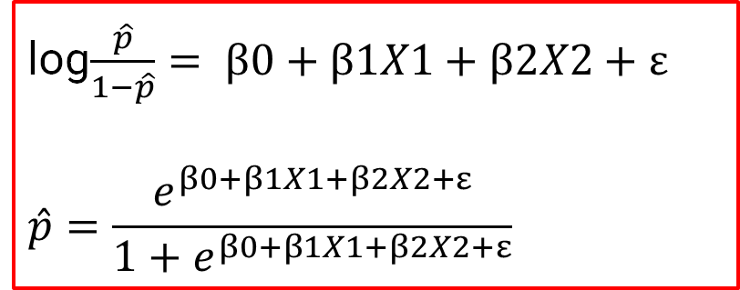
Supervised Learning: Fitting lines
log$\frac{\hat{p}}{1−\hat{p}}= β0+β1X1+β2X2+ε$
$$\hat{p}=\frac{e^{β0+β1X1+β2X2+ε}}{1+e^{β0+β1X1+β2X2+ε}}$$
Logistic Function
Notes:
Duration: 10 minutes
Highlights:
Introduce the definition.
Identify the unique attributes.
Provide examples to elaborate the concept and non-examples to show the difference.
Use whiteboard if required.
Key Takeaways:
In what ways, learners can use the concept in real-life situations to provide solutions or solve problems.

Slide 19
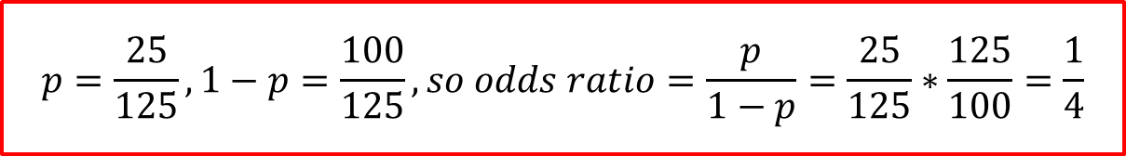
Classification Problems: Class Exercise
Imagine that there are 125 customers of age 25 years. Of them, 25 have subscribed to a premium subscription of an OTT platform. Find out the odds ratio.
$$p=\frac{25}{125}, 1−p=\frac{100}{125}, so odds ratio=\frac{p}{1−p}=\frac{25}{125}∗\frac{125}{100}=\frac{1}{4}$$
Notes:
Duration: 10 minutes
Highlights:
Introduce the definition.
Identify the unique attributes.
Provide examples to elaborate the concept and non-examples to show the difference.
Use whiteboard if required.
Key Takeaways:
In what ways, learners can use the concept in real-life situations to provide solutions or solve problems.

Slide 20
Interpreting Coefficients of a Logistic Model

Slide 21

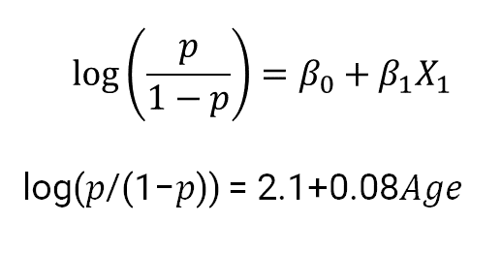
Interpreting Logistic Regression Coefficients
Predicting churn based on a person’s age
$$\log\left(\frac{p}{1−p}\right)=β_{0}+β_{1}X_{1}$$
log⁡(𝑝/(1−𝑝)) = 2.1+0.08𝐴𝑔𝑒
Age | Churned
28 | Yes
32 | Yes
40 | No
Notes:
Duration: 10 minutes
Highlights:
Introduce the definition.
Identify the unique attributes.
Provide examples to elaborate the concept and non-examples to show the difference.
Use whiteboard if required.
Key Takeaways:
In what ways, learners can use the concept in real-life situations to provide solutions or solve problems.

Slide 22
Interpreting Logistic Regression Coefficients
Predicting churn based on a person’s age
$$\log\left(\frac{p}{1−p}\right)=β_{0}+β_{1}X_{1}$$
log⁡(𝑝/(1−𝑝)) = 2.1+0.08𝐴𝑔𝑒
Changing Age by 1 unit will change the log odds of someone churning by 0.08 units.
Notes:
Duration: 10 minutes
Highlights:
Introduce the definition.
Identify the unique attributes.
Provide examples to elaborate the concept and non-examples to show the difference.
Use whiteboard if required.
Key Takeaways:
In what ways, learners can use the concept in real-life situations to provide solutions or solve problems.

Slide 23
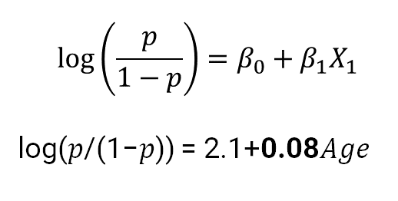
Interpreting Logistic Regression Coefficients
Predicting churn based on a person’s age
$$\log\left(\frac{p}{1−p}\right)=β_{0}+β_{1}X_{1}$$
log⁡(𝑝/(1−𝑝)) = 2.1+0.08𝐴𝑔𝑒
Changing Age by 1 unit will change the log odds of someone churning by 0.08 units.
Notes:
Duration: 10 minutes
Highlights:
Introduce the definition.
Identify the unique attributes.
Provide examples to elaborate the concept and non-examples to show the difference.
Use whiteboard if required.
Key Takeaways:
In what ways, learners can use the concept in real-life situations to provide solutions or solve problems.

Slide 24
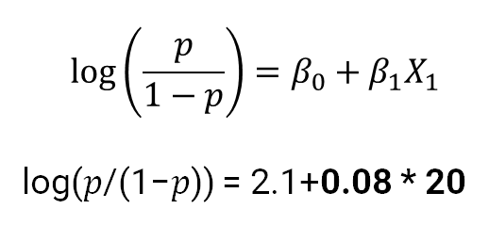
Interpreting Logistic Regression Coefficients
Predicting churn based on a person’s age
$$\log\left(\frac{p}{1−p}\right)=β_{0}+β_{1}X_{1}$$
log⁡(𝑝/(1−𝑝)) = 2.1+0.08 * 20
Notes:
Duration: 10 minutes
Highlights:
Introduce the definition.
Identify the unique attributes.
Provide examples to elaborate the concept and non-examples to show the difference.
Use whiteboard if required.
Key Takeaways:
In what ways, learners can use the concept in real-life situations to provide solutions or solve problems.

Slide 25
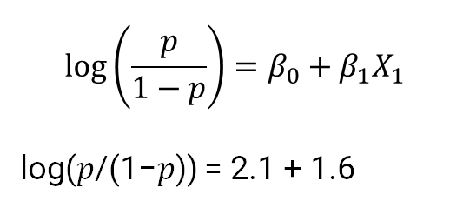
Interpreting Logistic Regression Coefficients
Predicting churn based on a person’s age
$$\log\left(\frac{p}{1−p}\right)=β_{0}+β_{1}X_{1}$$
log(𝑝/(1−𝑝)) = 2.1 + 1.6
Notes:
Duration: 10 minutes
Highlights:
Introduce the definition.
Identify the unique attributes.
Provide examples to elaborate the concept and non-examples to show the difference.
Use whiteboard if required.
Key Takeaways:
In what ways, learners can use the concept in real-life situations to provide solutions or solve problems.

Slide 26
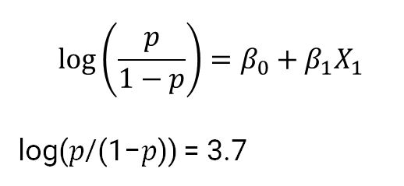
Interpreting Logistic Regression Coefficients
Predicting churn based on a person’s age
$$\log\left(\frac{p}{1−p}\right)=β_{0}+β_{1}X_{1}$$
log⁡(𝑝/(1−𝑝)) = 3.7
Notes:
Duration: 10 minutes
Highlights:
Introduce the definition.
Identify the unique attributes.
Provide examples to elaborate the concept and non-examples to show the difference.
Use whiteboard if required.
Key Takeaways:
In what ways, learners can use the concept in real-life situations to provide solutions or solve problems.

Slide 27

Interpreting Logistic Regression Coefficients
Predicting churn based on a person’s age
$$\log\left(\frac{p}{1−p}\right)=β_{0}+β_{1}X_{1}$$
log⁡(𝑝/(1−𝑝)) = $e^{3.7}$
Notes:
Duration: 10 minutes
Highlights:
Introduce the definition.
Identify the unique attributes.
Provide examples to elaborate the concept and non-examples to show the difference.
Use whiteboard if required.
Key Takeaways:
In what ways, learners can use the concept in real-life situations to provide solutions or solve problems.

Slide 28
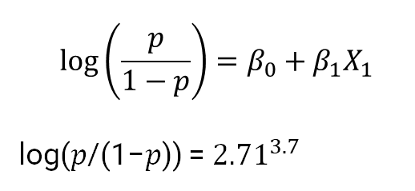
Interpreting Logistic Regression Coefficients
Predicting churn based on a person’s age
$$\log\left(\frac{p}{1−p}\right)=β_{0}+β_{1}X_{1}$$
log⁡(𝑝/(1−𝑝)) = ${2.71}^{3.7}$
Notes:
Duration: 10 minutes
Highlights:
Introduce the definition.
Identify the unique attributes.
Provide examples to elaborate the concept and non-examples to show the difference.
Use whiteboard if required.
Key Takeaways:
In what ways, learners can use the concept in real-life situations to provide solutions or solve problems.

Slide 29
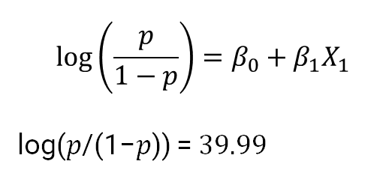
Interpreting Logistic Regression Coefficients
Predicting churn based on a person’s age
$$\log\left(\frac{p}{1−p}\right)=β_{0}+β_{1}X_{1}$$
log⁡(𝑝/(1−𝑝)) =$39.99$
Notes:
Duration: 10 minutes
Highlights:
Introduce the definition.
Identify the unique attributes.
Provide examples to elaborate the concept and non-examples to show the difference.
Use whiteboard if required.
Key Takeaways:
In what ways, learners can use the concept in real-life situations to provide solutions or solve problems.

Slide 30
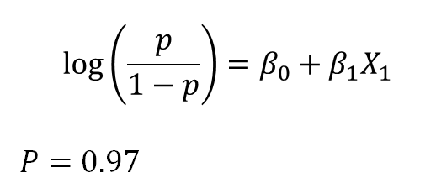
Interpreting Logistic Regression Coefficients
Predicting churn based on a person’s age
$$\log\left(\frac{p}{1−p}\right)=β_{0}+β_{1}X_{1}$$
$$P=0.97$$
Notes:
Duration: 10 minutes
Highlights:
Introduce the definition.
Identify the unique attributes.
Provide examples to elaborate the concept and non-examples to show the difference.
Use whiteboard if required.
Key Takeaways:
In what ways, learners can use the concept in real-life situations to provide solutions or solve problems.

Slide 31
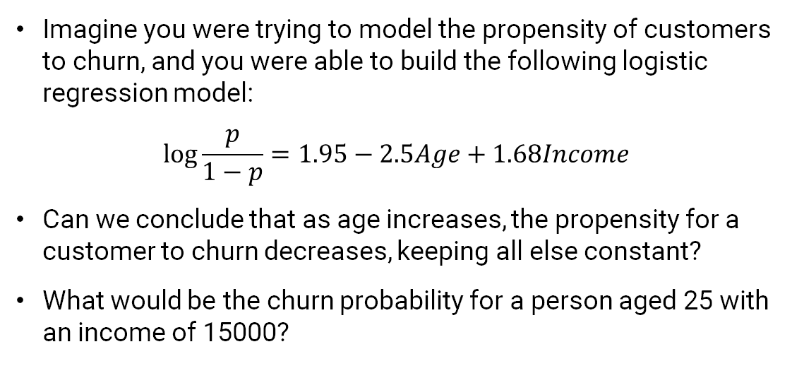
Class Exercise
Imagine you were trying to model the propensity of customers to churn, and you were able to build the following logistic regression model:
$$log\frac{p}{1−p}=1.95−2.5Age+1.68Income{ }$$
Can we conclude that as age increases, the propensity for a customer to churn decreases, keeping all else constant?
What would be the churn probability for a person aged 25 with an income of 15000?
Notes:
Duration: 10 minutes
Highlights:
Introduce the definition.
Identify the unique attributes.
Provide examples to elaborate the concept and non-examples to show the difference.
Use whiteboard if required.
Key Takeaways:
In what ways, learners can use the concept in real-life situations to provide solutions or solve problems.

Slide 32
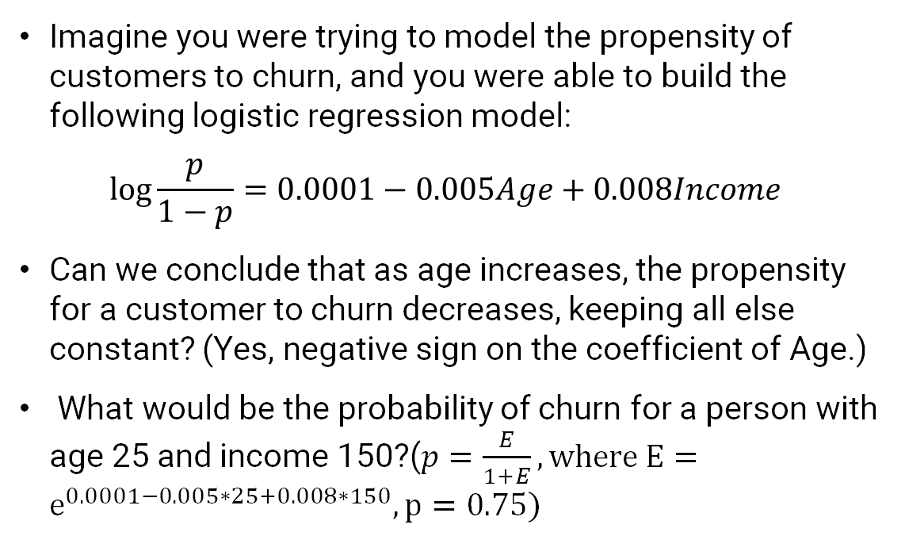
Class Exercise
Imagine you were trying to model the propensity of customers to churn, and you were able to build the following logistic regression model:
$$log\frac{p}{1−p}=0.0001−0.005Age+0.008Income{ }$$
Can we conclude that as age increases, the propensity for a customer to churn decreases, keeping all else constant? (Yes, negative sign on the coefficient of Age.)
What would be the probability of churn for a person with age 25 and income 150?($p=\frac{E}{1+E}, where E=e^{0.0001−0.005∗25+0.008∗150}, p=0.75)$
Notes:
Duration: 10 minutes
Highlights:
Introduce the definition.
Identify the unique attributes.
Provide examples to elaborate the concept and non-examples to show the difference.
Use whiteboard if required.
Key Takeaways:
In what ways, learners can use the concept in real-life situations to provide solutions or solve problems.

Slide 33
Finding Out the Optimal Coefficients

Slide 34
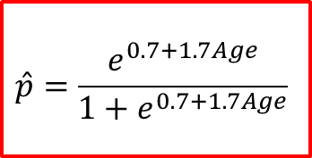

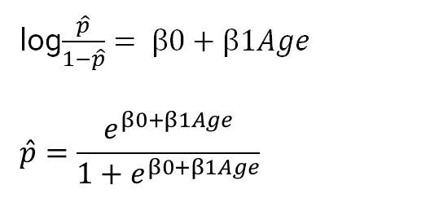
Estimating Coefficients of Logistic Model
Age | Good_Bad (Good =1) | Prediction
20 | 1
21 | 1
24 | 0
25 | 0
29 | 0
30 | 1
38 | 1
log$\frac{\hat{p}}{1−\hat{p}}= β0+β1Age$
$$\hat{p}=\frac{e^{β0+β1Age}}{1+e^{β0+β1Age}}$$
$$β0=0.7$$
$$β_{1}=1.7$$
$$\hat{p}=\frac{e^{0.7+1.7Age}}{1+e^{0.7+1.7Age}}$$
Notes:
Duration: 10 minutes
Highlights:
Introduce the definition.
Identify the unique attributes.
Provide examples to elaborate the concept and non-examples to show the difference.
Use whiteboard if required.
Key Takeaways:
In what ways, learners can use the concept in real-life situations to provide solutions or solve problems.

Slide 35

Estimating Coefficients of Logistic Model
Age | Good_Bad (Good =1) | Prediction
20 | 1
21 | 1
24 | 0
25 | 0
29 | 0
30 | 1
38 | 1
log$\frac{\hat{p}}{1−\hat{p}}= β0+β1Age$
$$\hat{p}=\frac{e^{β0+β1Age}}{1+e^{β0+β1Age}}$$
Age | Good_Bad (Good =1) | Prediction
20 | 1
21 | 1
24 | 0
25 | 0
29 | 0
30 | 1
38 | 1
$$β0=0.3$$
$$β_{1}=2.2$$
$$β0=0.7$$
$$β_{1}=1.7$$
Notes:
Duration: 10 minutes
Highlights:
Introduce the definition.
Identify the unique attributes.
Provide examples to elaborate the concept and non-examples to show the difference.
Use whiteboard if required.
Key Takeaways:
In what ways, learners can use the concept in real-life situations to provide solutions or solve problems.

Slide 36
Estimating Coefficients of Logistic Model
Age | Good_Bad (Good =1) | Prediction
20 | 1
21 | 1
24 | 0
25 | 0
29 | 0
30 | 1
38 | 1
log$\frac{\hat{p}}{1−\hat{p}}= β0+β1Age$
$$\hat{p}=\frac{e^{β0+β1Age}}{1+e^{β0+β1Age}}$$
Age | Good_Bad (Good =1) | Prediction
20 | 1 | 0.70
21 | 1 | 0.60
24 | 0 | 0.50
25 | 0 | 0.45
29 | 0 | 0.70
30 | 1 | 0.62
38 | 1 | 0.40
$$β0=0.3$$
$$β_{1}=2.2$$
$$β0=0.7$$
$$β_{1}=1.7$$
Notes:
Duration: 10 minutes
Highlights:
Introduce the definition.
Identify the unique attributes.
Provide examples to elaborate the concept and non-examples to show the difference.
Use whiteboard if required.
Key Takeaways:
In what ways, learners can use the concept in real-life situations to provide solutions or solve problems.

Slide 37
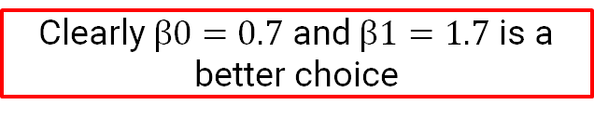
Estimating Coefficients of Logistic Model
Age | Good_Bad (Good =1) | Prediction
20 | 1
21 | 1
24 | 0
25 | 0
29 | 0
30 | 1
38 | 1
log$\frac{\hat{p}}{1−\hat{p}}= β0+β1Age$
$$\hat{p}=\frac{e^{β0+β1Age}}{1+e^{β0+β1Age}}$$
Age | Good_Bad (Good =1) | Prediction
20 | 1 | 0.70
21 | 1 | 0.60
24 | 0 | 0.50
25 | 0 | 0.45
29 | 0 | 0.70
30 | 1 | 0.62
38 | 1 | 0.40
$$β0=0.3$$
$$β_{1}=2.2$$
$$β0=0.7$$
$$β_{1}=1.7$$
Clearly $β0=0.7$ and $β1=1.7$ is a better choice
Notes:
Duration: 10 minutes
Highlights:
Introduce the definition.
Identify the unique attributes.
Provide examples to elaborate the concept and non-examples to show the difference.
Use whiteboard if required.
Key Takeaways:
In what ways, learners can use the concept in real-life situations to provide solutions or solve problems.

Slide 38

Estimating Coefficients of Logistic Model
One would like to choose the model coefficients so that the model gives a high score to events and a low score to non-events.
But how will we measure a model’s ability to assign a high score to events and a low to non-events? Cost Function. See the excel sheet logistic_cost.xlsx
Notes:
Duration: 10 minutes
Highlights:
Introduce the definition.
Identify the unique attributes.
Provide examples to elaborate the concept and non-examples to show the difference.
Use whiteboard if required.
Key Takeaways:
In what ways, learners can use the concept in real-life situations to provide solutions or solve problems.

